Slide 1
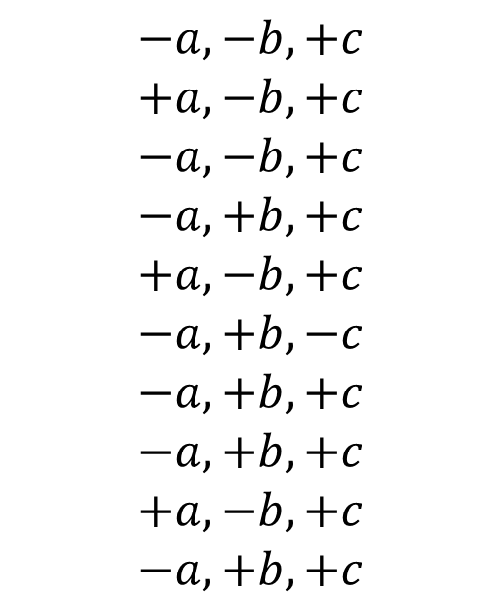
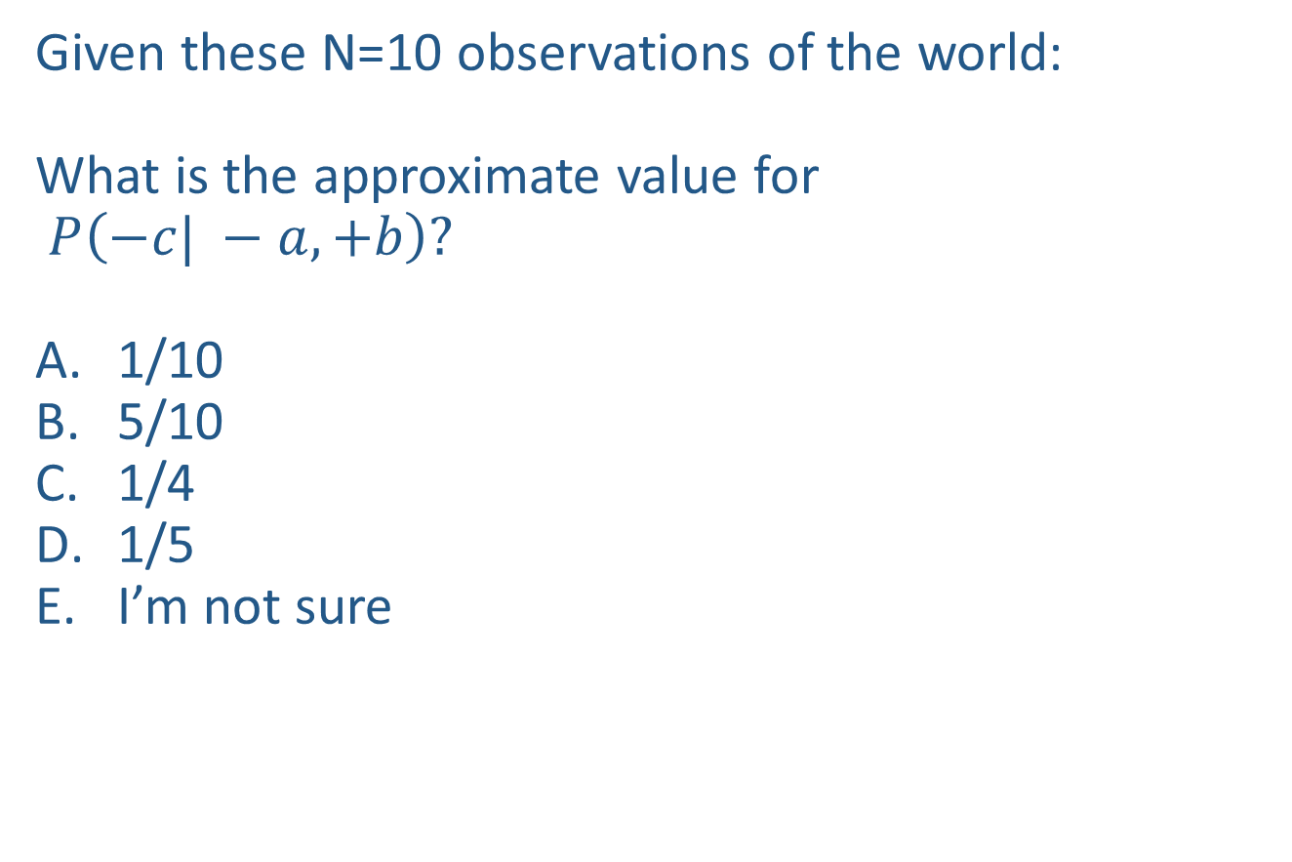

Warm-up as you walk in
Given these N=10 observations of the world:
What is the approximate value for
$P\left(−c| −a, +b\right)?$
1/10
5/10
1/4
1/5
I’m not sure
Counts
$$−a, −b, +c$$
$$+a,−b, +c$$
$$−a, −b,+c$$
$$−a, +b, +c$$
$$+a, −b, +c$$
$$−a, +b, −c$$
$$−a, +b, +c$$
$$−a, +b, +c$$
$$+a, −b, +c$$
$$−a, +b, +c$$
+a | +b | +c | 0
+a | +b | -c | 0
+a | -b | +c | 3
+a | -b | -c | 0
-a | +b | +c | 4
-a | +b | -c | 1
-a | -b | +c | 2
-a | -b | -c | 0

Slide 2

Announcements
Assignments
HW10
Due Tue 4/16
P5
Adjusted Plan: Out Wednesday, due 5/2

Slide 3
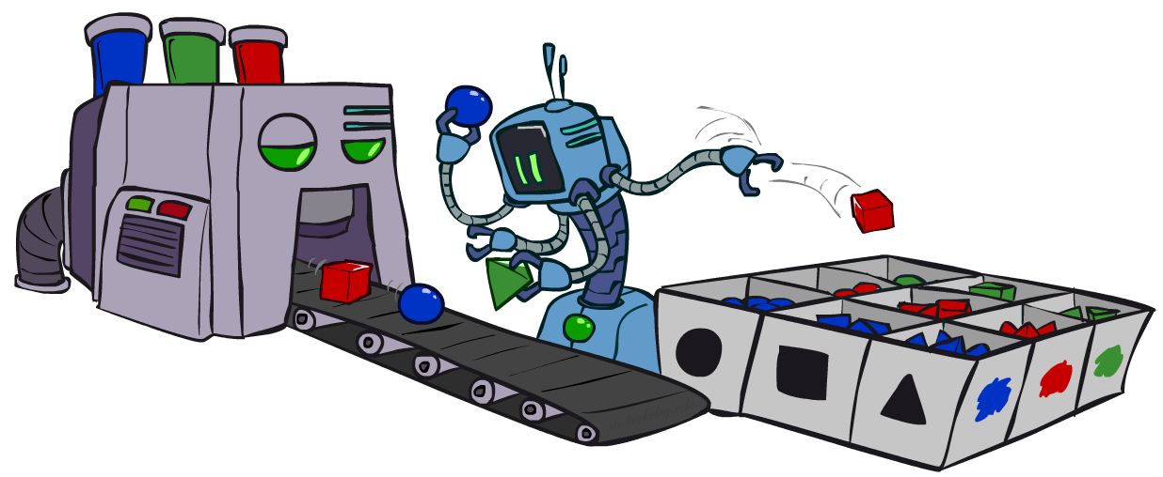
AI: Representation and Problem Solving
Bayes Nets Sampling
Instructors: Pat Virtue & Stephanie Rosenthal
Slide credits: CMU AI and http://ai.berkeley.edu

Slide 4
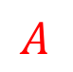

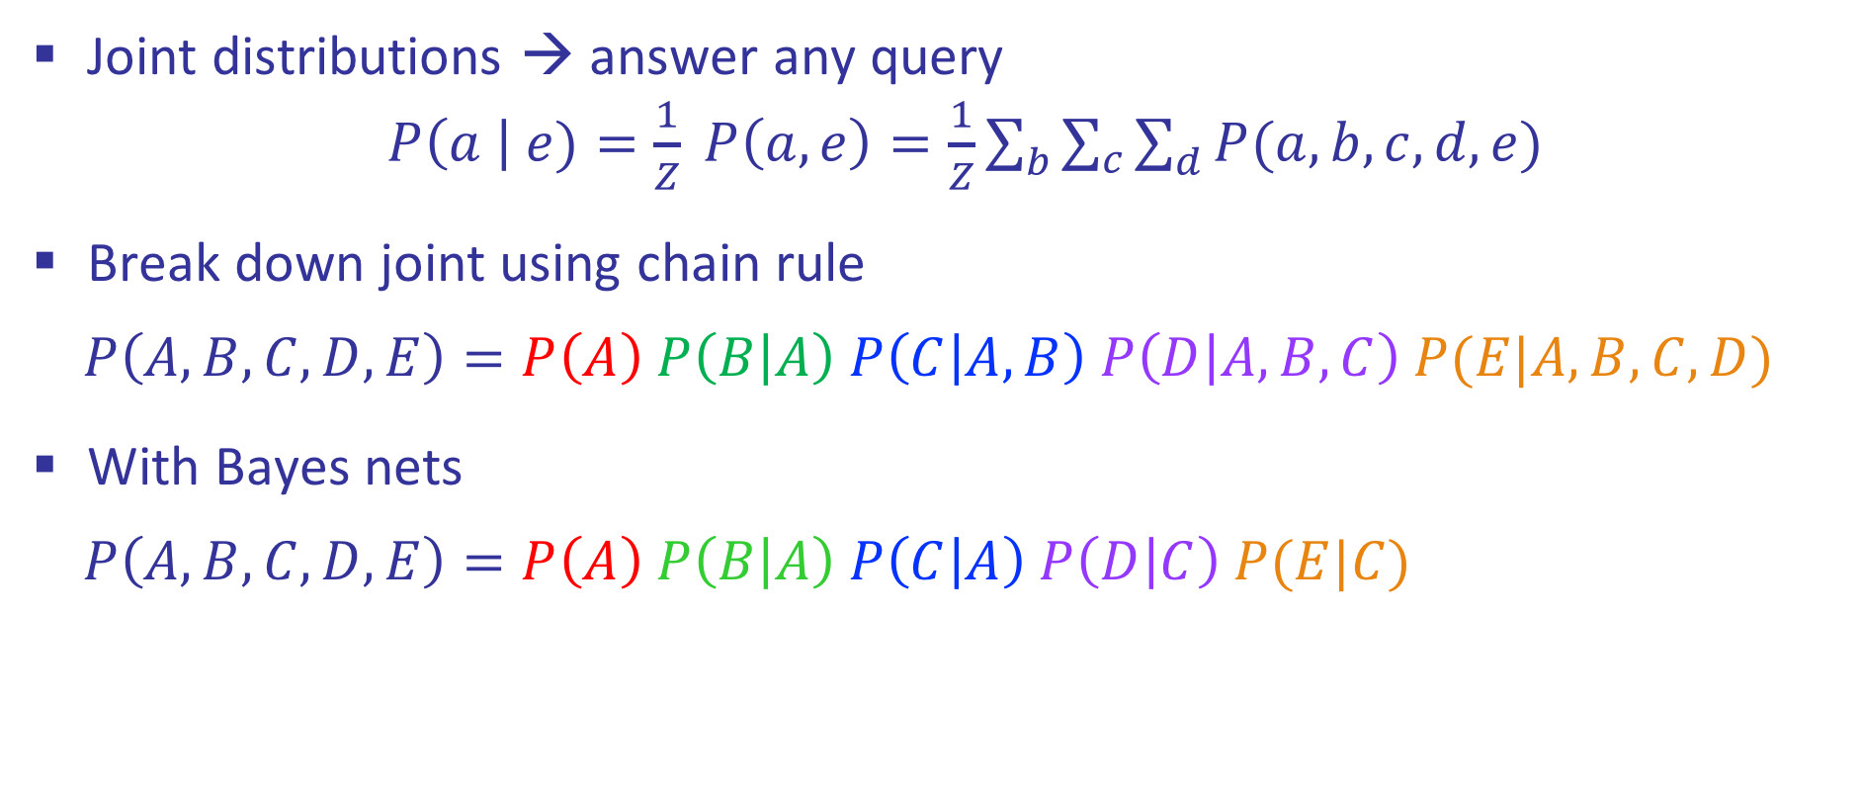

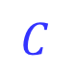

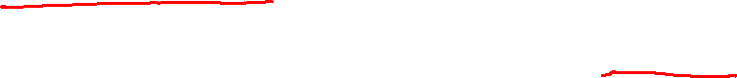
Review: Bayes Nets
Joint distributions → answer any query
$P\left(a \right| e)=\frac{1}{Z} P\left(a, e\right)=\frac{1}{Z}\sum_{b}{\sum_{c}{\sum_{d}{P(a,b, c, d, e)}}}$
Break down joint using chain rule
$$P\left(A,B,C,D,E\right)=P\left(A\right) P\left(B | A\right) P\left(C | A,B\right) P\left(D | A,B,C\right) P(E|A,B,C,D)$$
With Bayes nets
$$P\left(A,B,C,D,E\right)=P\left(A\right) P\left(B | A\right) P\left(C | A\right) P\left(D | C\right) P(E|C)$$
$$A$$
$$B$$
$$C$$
$$D$$
$$E$$

Slide 5
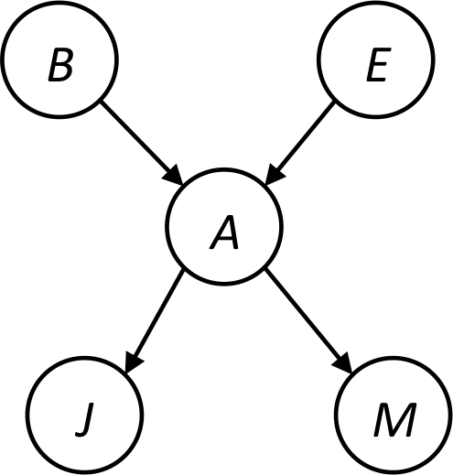
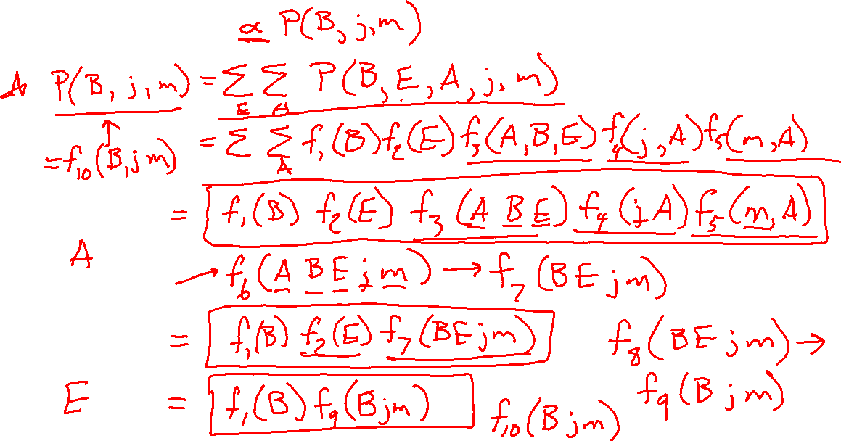
Variable Elimination Example
Query P(B | j, m)

Slide 6

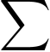
Example
Query P(B | j,m)
P(B) P(E) P(A|B,E) P(j|A) P(m|A)
Choose A
P(A|B,E)
P(j|A)
P(m|A)
P(A,j,m|B,E)
P(j,m|B,E)
P(B) P(E) P(j,m|B,E)

Slide 7
Example
P(B) P(E) P(j,m|B,E)
Choose E
P(E)
P(j,m|B,E)
P(E,j,m|B)
P(j,m|B)
P(B) P(j,m|B)
Finish with B
P(B)
P(j,m|B)
P(j,m,B)
Normalize
P(B | j,m)

Slide 8

Variable Elimination order matters
Order the terms D, Z, A, B C
P(D) = α ∑_{z,a,b,c} P(D|z) P(z) P(a|z) P(b|z) P(c|z)
= α ∑_{z} P(D|z) P(z) ∑_{a} P(a|z) ∑_{b} P(b|z) ∑_{c} P(c|z)
Largest factor has 2 variables (D,Z)
Order the terms A, B C, D, Z
P(D) = α ∑_{a,b,c,z} P(a|z) P(b|z) P(c|z) P(D|z) P(z)
= α ∑_{a} ∑_{b} ∑_{c} ∑_{z} P(a|z) P(b|z) P(c|z) P(D|z) P(z)
Largest factor has 4 variables (A,B,C,D)
In general, with n leaves, factor of size 2^{n}
Z
A
B
C
D

Slide 9
VE: Computational and Space Complexity
The computational and space complexity of variable elimination is determined by the largest factor (and it’s space that kills you)
The elimination ordering can greatly affect the size of the largest factor.
E.g., previous slide’s example 2^{n} vs. 2
Does there always exist an ordering that only results in small factors?
No!

Slide 10
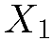
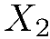
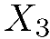
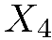
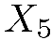
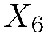
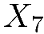
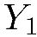
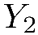
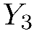
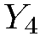
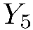
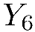
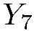
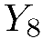
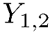
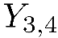
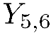
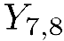
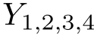
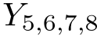
VE: Computational and Space Complexity
Inference in Bayes’ nets is NP-hard.
No known efficient probabilistic inference in general.

Slide 11
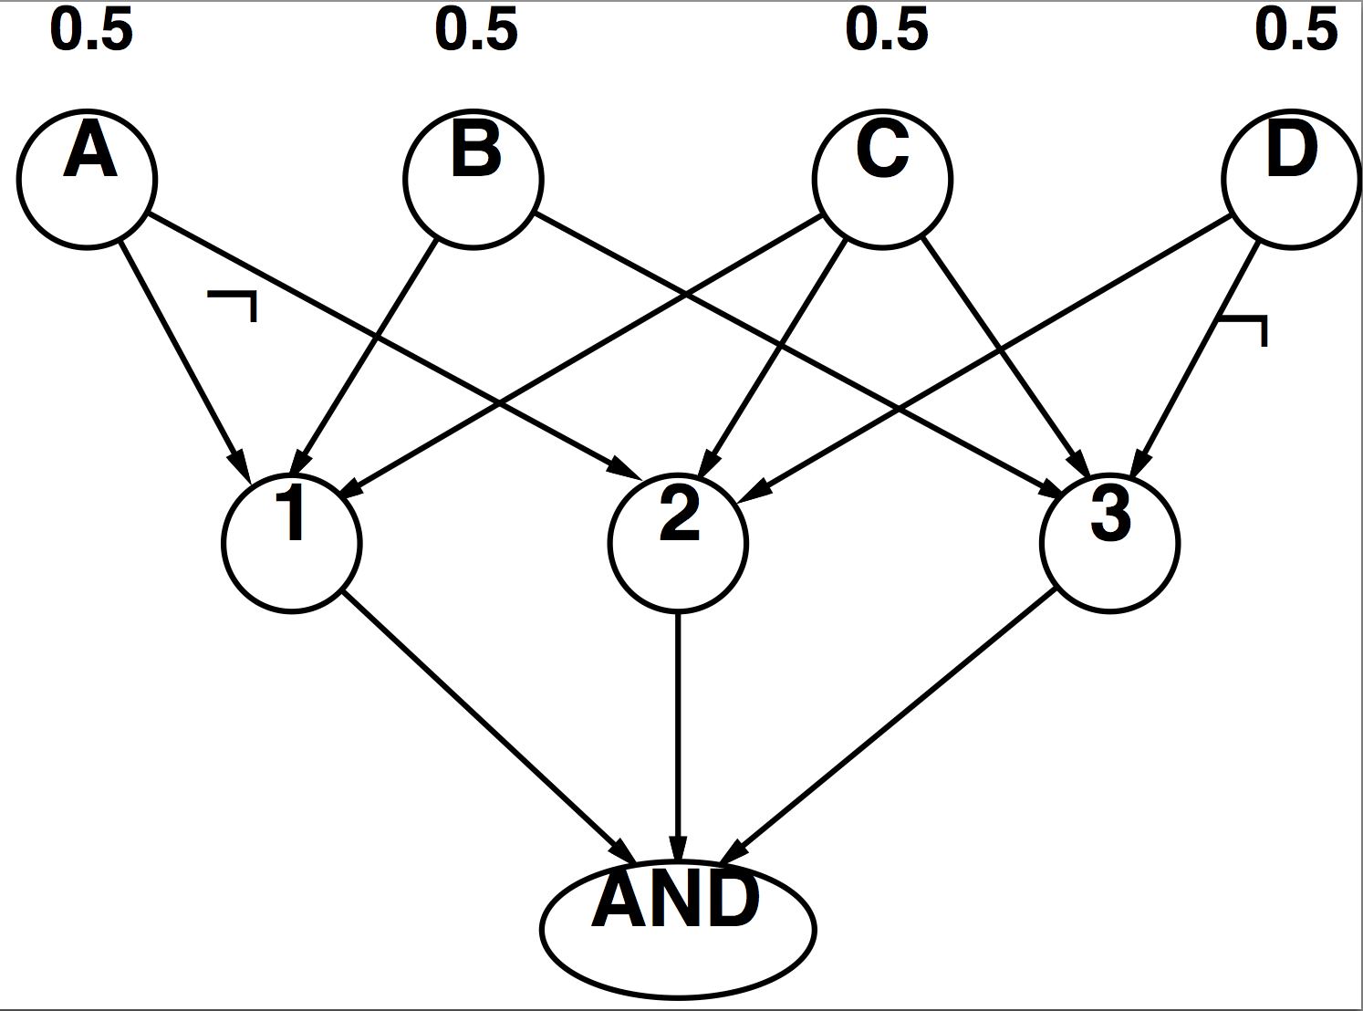
Worst Case Complexity? Reduction from SAT
CNF clauses:
A v B v C
C v D v ¬A
B v C v ¬D
P(AND) > 0 iff clauses are satisfiable
=> NP-hard
P(AND) = S x 0.5^{n} where S is the number of satisfying assignments for clauses
=> #P-hard
Notes:
Make this model simpler (no reason for fan-in constraint)

Slide 12
Polytrees
A polytree is a directed graph with no undirected cycles
For poly-trees the complexity of variable elimination is linear in the network size if you eliminate from the leave towards the roots
This is essentially the same theorem as for tree-structured CSPs

Slide 13


Bayes Nets
Part I: Representation
Part II: Exact inference
Enumeration (always exponential complexity)
Variable elimination (worst-case exponential complexity, often better)
Inference is NP-hard in general
Part III: Approximate Inference

Slide 14
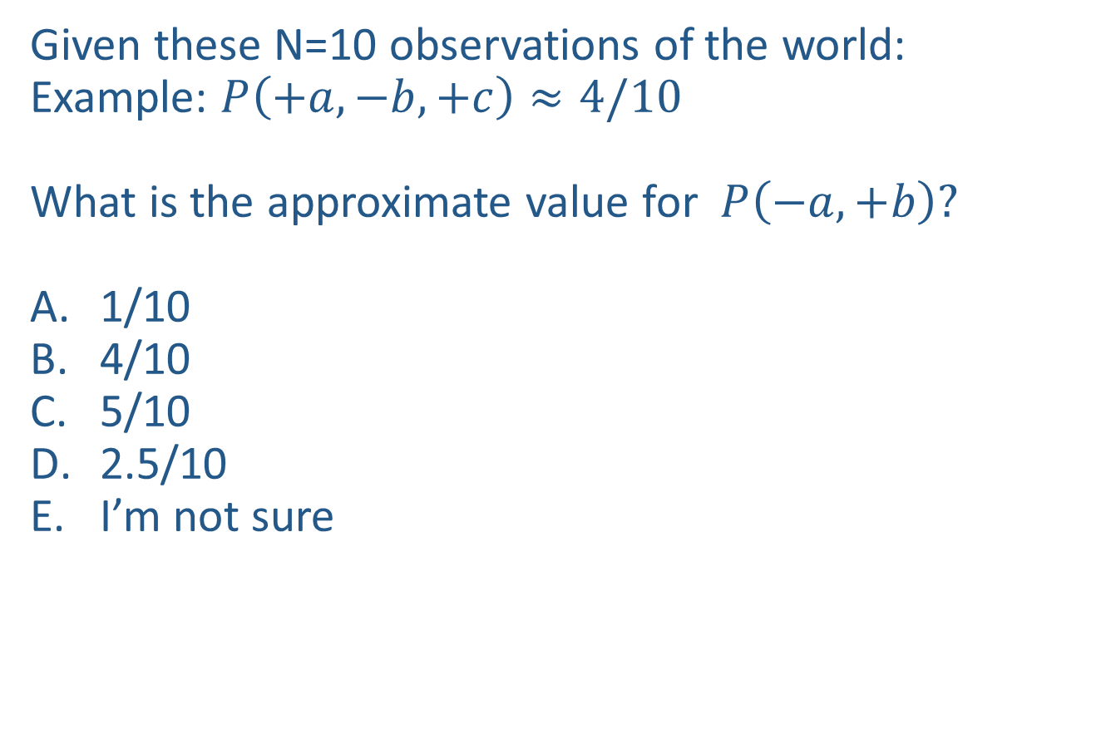
Quick Question
Given these N=10 observations of the world:
Example: $P\left(+a, −b,+c\right)≈4/10$
What is the approximate value for $P\left(−a, +b\right)?$
1/10
4/10
5/10
2.5/10
I’m not sure
Counts
$$−a, −b, +c$$
$$+a,−b, +c$$
$$−a, −b,+c$$
$$−a, +b, +c$$
$$+a, −b, +c$$
$$−a, +b, −c$$
$$−a, +b, +c$$
$$−a, +b, +c$$
$$+a, −b, +c$$
$$−a, +b, +c$$
+a | +b | +c | 0
+a | +b | -c | 0
+a | -b | +c | 3
+a | -b | -c | 0
-a | +b | +c | 4
-a | +b | -c | 1
-a | -b | +c | 2
-a | -b | -c | 0

Slide 15

Warm-up as you walk in
Given these N=10 observations of the world:
What is the approximate value for
$P\left(−c| −a, +b\right)?$
1/10
5/10
1/4
1/5
I’m not sure
Counts
$$−a, −b, +c$$
$$+a,−b, +c$$
$$−a, −b,+c$$
$$−a, +b, +c$$
$$+a, −b, +c$$
$$−a, +b, −c$$
$$−a, +b, +c$$
$$−a, +b, +c$$
$$+a, −b, +c$$
$$−a, +b, +c$$
+a | +b | +c | 0
+a | +b | -c | 0
+a | -b | +c | 3
+a | -b | -c | 0
-a | +b | +c | 4
-a | +b | -c | 1
-a | -b | +c | 2
-a | -b | -c | 0

Slide 16
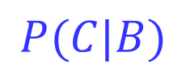


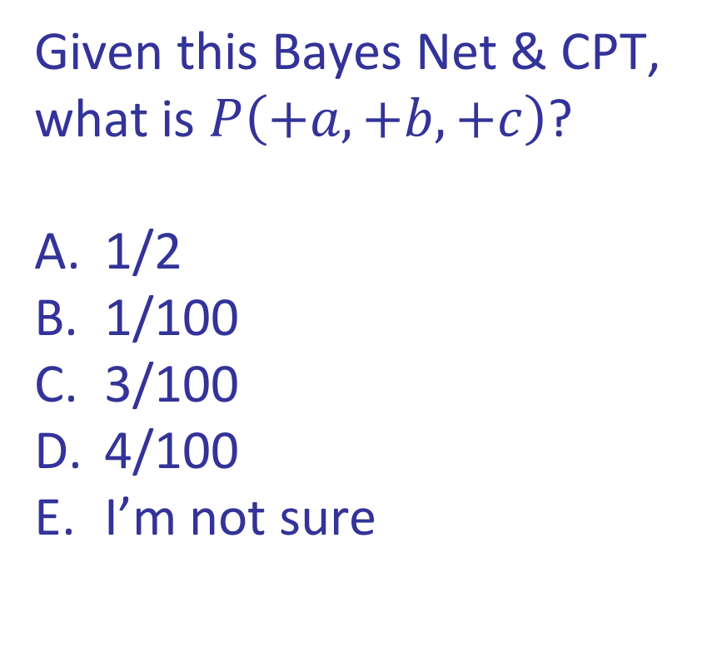
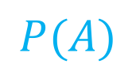
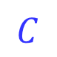

Quick Question
Given this Bayes Net & CPT,
what is $P\left(+a,+b,+c\right)$?
1/2
1/100
3/100
4/100
I’m not sure
+a | 1/2
-a | 1/2
$$P(A)$$
$$A$$
+a | +b | 1/10
 | -b | 9/10
-a | +b | 1/2
 | -b | 1/2
$$P(B|A)$$
$$B$$
+b | +c | 4/5
 | -c | 1/5
-b | +c | 1
 | -c | 0
$$C$$
$$P(C|B)$$

Slide 17

Approximate Inference: Sampling

Slide 18
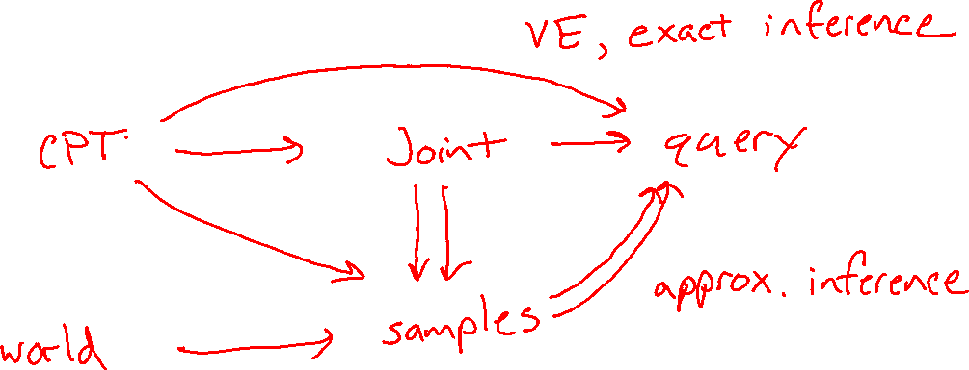
Inference vs Sampling

Slide 19
Motivation for Approximate Inference
Inference in Bayes’ nets is NP-hard.
No known efficient probabilistic inference in general.

Slide 20
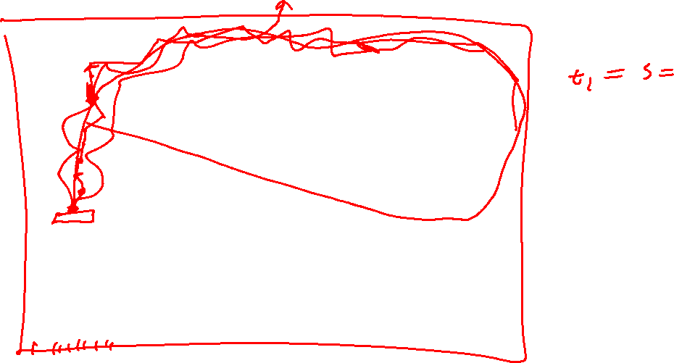
Motivation for Approximate Inference

Slide 21

Sampling
Sampling is a lot like repeated simulation
Predicting the weather, basketball games, …
Basic idea
Draw N samples from a sampling distribution S
Compute an approximate posterior probability
Show this converges to the true probability P
Why sample?
Learning: get samples from a distribution you don’t know
Inference: getting a sample is faster than computing the right answer (e.g. with variable elimination)

Slide 22
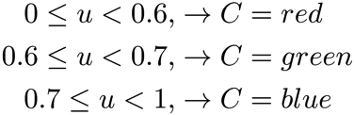


Sampling
Sampling from given distribution
Step 1: Get sample u from uniform distribution over [0, 1)
e.g. random() in python
Step 2: Convert this sample u into an outcome for the given distribution by having each outcome associated with a sub-interval of [0,1) with sub-interval size equal to probability of the outcome
Example
If random() returns u = 0.83, then our sample is C = blue
E.g, after sampling 8 times:
C | P(C)
red | 0.6
green | 0.1
blue | 0.3

Slide 23
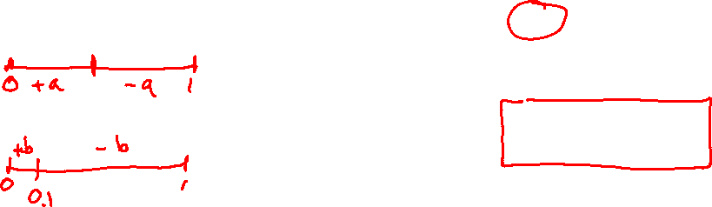
Sampling
How would you sample from a conditional distribution?
+a | 1/2
-a | 1/2
$$P(A)$$
$$A$$
+a | +b | 1/10
 | -b | 9/10
-a | +b | 1/2
 | -b | 1/2
$$P(B|A)$$
$$B$$

Slide 24
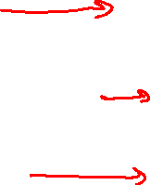
Sampling in Bayes’ Nets
Prior Sampling
Rejection Sampling
Likelihood Weighting
Gibbs Sampling

Slide 25
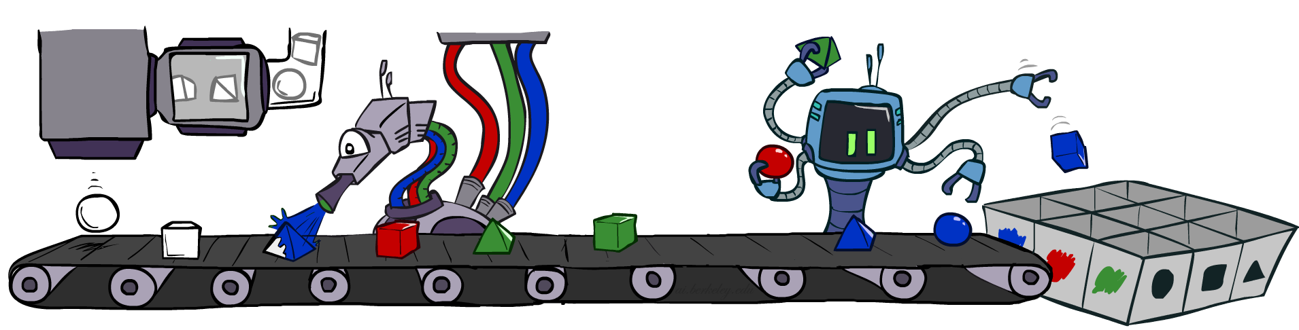
Prior Sampling

Slide 26
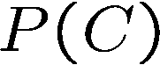
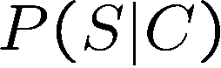
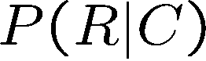
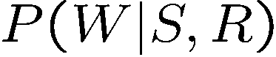
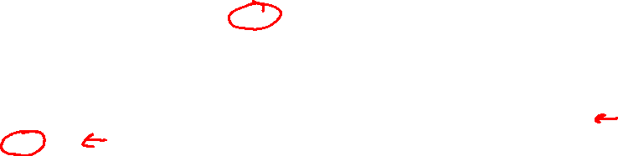
Prior Sampling
+c | 0.5
-c | 0.5
Cloudy
Cloudy
+c | +s | 0.1
 | -s | 0.9
-c | +s | 0.5
 | -s | 0.5
+c | +r | 0.8
 | -r | 0.2
-c | +r | 0.2
 | -r | 0.8
Sprinkler
Sprinkler
Rain
Rain
WetGrass
WetGrass
Samples:
+s | +r | +w | 0.99
 |  | -w | 0.01
 | -r | +w | 0.90
 |  | -w | 0.10
-s | +r | +w | 0.90
 |  | -w | 0.10
 | -r | +w | 0.01
 |  | -w | 0.99
+c, -s, +r, +w
-c, +s, -r, +w
…

Slide 27
Prior Sampling
For i=1, 2, …, n
Sample x_{i} from P(X_{i} | Parents(X_{i}))
Return (x₁, x₂, …, x_{n})

Slide 28
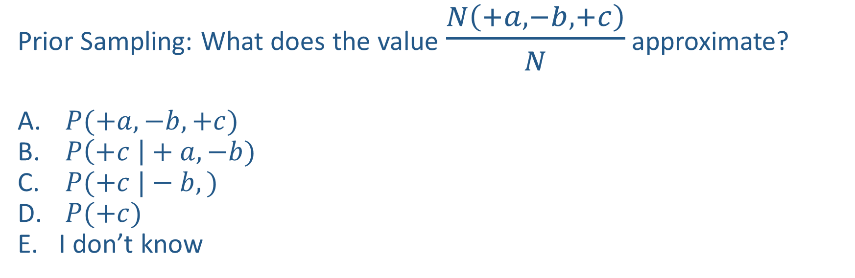
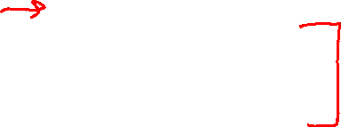
Piazza Poll 1
Prior Sampling: What does the value $\frac{N\left(+a, −b, +c\right)}{N}$ approximate?
$P(+a, −b, +c)$
$P\left(+c \right|+a, −b)$
$P(+c |−b,)$
$P(+c)$
I don’t know

Slide 29


Piazza Poll 2
How many $\{−a,+b,−c\}$ samples out of N=1000
should we expect?
1
50
125
200
I have no idea
+a | 1/2
-a | 1/2
$$P(A)$$
$$A$$
+a | +b | 1/10
 | -b | 9/10
-a | +b | 1/2
 | -b | 1/2
$$P(B|A)$$
$$B$$
+b | +c | 4/5
 | -c | 1/5
-b | +c | 1
 | -c | 0
$$C$$
$$P(C|B)$$

Slide 30

Probability of a sample
Given this Bayes Net & CPT,
what is $P\left(+a,+b,+c\right)$?
Algorithm: Multiply likelihood of each node given parents:
+a | 1/2
-a | 1/2
$$P(A)$$
$$A$$
+a | +b | 1/10
 | -b | 9/10
-a | +b | 1/2
 | -b | 1/2
$$P(B|A)$$
w = 1.0
for i=1, 2, …, n
Set w = w * P(x_{i} | Parents(X_{i}))
return w
$$B$$
+b | +c | 4/5
 | -c | 1/5
-b | +c | 1
 | -c | 0
$$C$$
$$P(C|B)$$

Slide 31




Prior Sampling
This process generates samples with probability:
…i.e. the BN’s joint probability
Let the number of samples of an event be
Then
i.e., the sampling procedure is consistent

Slide 32

Example
We’ll get a bunch of samples from the BN:
+c, -s, +r, +w
+c, +s, +r, +w
-c, +s, +r, -w
+c, -s, +r, +w
-c, -s, -r, +w
If we want to know P(W)
We have counts <+w:4, -w:1>
Normalize to get P(W) = <+w:0.8, -w:0.2>
This will get closer to the true distribution with more samples
Can estimate anything else, too
What about P(C| +w)? P(C| +r, +w)? P(C| -r, -w)?
Fast: can use fewer samples if less time (what’s the drawback?)
C
S
R
W

Slide 33

Rejection Sampling

Slide 34

Rejection Sampling
Let’s say we want P(C)
No point keeping all samples around
Just tally counts of C as we go
Let’s say we want P(C| +s)
Same thing: tally C outcomes, but ignore (reject) samples which don’t have S=+s
This is called rejection sampling
It is also consistent for conditional probabilities (i.e., correct in the limit)
C
S
R
W
+c, -s, +r, +w
+c, +s, +r, +w
-c, +s, +r, -w
+c, -s, +r, +w
-c, -s, -r, +w

Slide 35

Rejection Sampling
IN: evidence instantiation
For i=1, 2, …, n
Sample x_{i} from P(X_{i} | Parents(X_{i}))
If x_{i} not consistent with evidence
Reject: Return, and no sample is generated in this cycle
Return (x₁, x₂, …, x_{n})

Slide 36


Piazza Poll 3
What queries can we answer with rejection samples (evidence: $+c$)?
$P(+a, −b, +c)$
$P(+a, −b |+c)$
Both
Neither
I have no idea

Slide 37


Likelihood Weighting

Slide 38




Likelihood Weighting
Problem with rejection sampling:
If evidence is unlikely, rejects lots of samples
Evidence not exploited as you sample
Consider P(Shape|blue)
Idea: fix evidence variables and sample the rest
Problem: sample distribution not consistent!
Solution: weight by probability of evidence given parents
pyramid, green
pyramid, red
sphere, blue
cube, red
sphere, green
pyramid, blue
pyramid, blue
sphere, blue
cube, blue
sphere, blue
Shape
Color
Shape
Color

Slide 39




Likelihood Weighting
+c | 0.5
-c | 0.5
Cloudy
Cloudy
+c | +s | 0.1
 | -s | 0.9
-c | +s | 0.5
 | -s | 0.5
+c | +r | 0.8
 | -r | 0.2
-c | +r | 0.2
 | -r | 0.8
Sprinkler
Sprinkler
Rain
Rain
WetGrass
Samples:
WetGrass
+s | +r | +w | 0.99
 |  | -w | 0.01
 | -r | +w | 0.90
 |  | -w | 0.10
-s | +r | +w | 0.90
 |  | -w | 0.10
 | -r | +w | 0.01
 |  | -w | 0.99
+c, +s, +r, +w
…

Slide 40


Likelihood Weighting
IN: evidence instantiation
w = 1.0
for i=1, 2, …, n
if X_{i} is an evidence variable
X_{i} = observation x_{i} for X_{i}
Set w = w * P(x_{i} | Parents(X_{i}))
else
Sample x_{i} from P(X_{i} | Parents(X_{i}))
return (x₁, x₂, …, x_{n}), w

Slide 41
Likelihood Weighting
No evidence:
Prior Sampling
Some evidence:
Likelihood Weighted Sampling
All evidence:
Likelihood Weighted
Input: no evidence
for i=1, 2, …, n
Sample x_{i} from P(X_{i} | Parents(X_{i}))
return (x₁, x₂, …, x_{n})
Input: evidence instantiation
w = 1.0
for i=1, 2, …, n
if X_{i} is an evidence variable
X_{i} = observation x_{i} for X_{i}
Set w = w * P(x_{i} | Parents(X_{i}))
else
Sample x_{i} from P(X_{i} | Parents(X_{i}))
return (x₁, x₂, …, x_{n}), w
Input: evidence instantiation
w = 1.0
for i=1, 2, …, n
Set w = w * P(x_{i} | Parents(X_{i}))
return w

Slide 42





Likelihood Weighting
Sampling distribution if z sampled and e fixed evidence
Now, samples have weights
Together, weighted sampling distribution is consistent
Cloudy
C
S
R
W

Slide 43

Piazza Poll 4
Two identical samples from likelihood weighted sampling will have the same exact weights.
True
False
It depends
I don’t know

Slide 44

Piazza Poll 5
What does the following likelihood weighted value approximate?
${weight}_{(+a,−b,+c)}⋅\frac{N\left(+a, −b, +c\right)}{N}$
$P(+a, −b, +c)$
$P\left(+a, −b \right|+c)$
I’m not sure

Slide 45

Likelihood Weighting
Likelihood weighting is good
We have taken evidence into account as we generate the sample
E.g. here, W’s value will get picked based on the evidence values of S, R
More of our samples will reflect the state of the world suggested by the evidence
Likelihood weighting doesn’t solve all our problems
Evidence influences the choice of downstream variables, but not upstream ones (C isn’t more likely to get a value matching the evidence)
We would like to consider evidence when we sample every variable

Slide 46
Likelihood Weighting
Likelihood weighting doesn’t solve all our problems
Evidence influences the choice of downstream variables, but not upstream ones (C isn’t more likely to get a value matching the evidence)
We would like to consider evidence when we sample every variable
→ Gibbs sampling

Slide 47

Gibbs Sampling

Slide 48
Gibbs Sampling
Procedure: keep track of a full instantiation x₁, x₂, …, x_{n}.
Start with an arbitrary instantiation consistent with the evidence.
Sample one variable at a time, conditioned on all the rest, but keep evidence fixed.
Keep repeating this for a long time.
Property: in the limit of repeating this infinitely many times the resulting sample is coming from the correct distribution
Rationale: both upstream and downstream variables condition on evidence.
In contrast: likelihood weighting only conditions on upstream evidence, and hence weights obtained in likelihood weighting can sometimes be very small. Sum of weights over all samples is indicative of how many “effective” samples were obtained, so want high weight.

Slide 49
Gibbs Sampling Example: P( S | +r)
Step 1: Fix evidence
R = +r
Steps 3: Repeat
Choose a non-evidence variable X
Resample X from P( X | all other variables)
Step 2: Initialize other variables
Randomly
C
C
S
+r
S
+r
W
W
C
C
C
C
C
C
S
+r
S
+r
S
+r
S
+r
S
+r
S
+r
W
W
W
W
W
W

Slide 50
Gibbs Sampling Example: P( S | +r)
Keep only the last sample from each iteration:
C
C
C
C
C
S
+r
S
+r
S
+r
S
+r
S
+r
W
W
W
W
W
C
C
C
C
C
S
+r
S
+r
S
+r
S
+r
S
+r
W
W
W
W
W
C
C
C
C
C
S
+r
S
+r
S
+r
S
+r
S
+r
W
W
W
W
W

Slide 51

Efficient Resampling of One Variable
Sample from P(S | +c, +r, -w)
Many things cancel out – only CPTs with S remain!
More generally: only CPTs that have resampled variable need to be considered, and joined together
C
S
+r
W

Slide 52
Further Reading on Gibbs Sampling
Gibbs sampling produces sample from the query distribution P( Q | e ) in limit of re-sampling infinitely often
Gibbs sampling is a special case of more general methods called Markov chain Monte Carlo (MCMC) methods
Metropolis-Hastings is one of the more famous MCMC methods (in fact, Gibbs sampling is a special case of Metropolis-Hastings)
You may read about Monte Carlo methods – they’re just sampling

Slide 53
Markov Chain Monte Carlo*
Idea: instead of sampling from scratch, create samples that are each like the last one.
Procedure: resample one variable at a time, conditioned on all the rest, but keep evidence fixed. E.g., for P(b|c):
Properties: Now samples are not independent (in fact they’re nearly identical), but sample averages are still consistent estimators!
What’s the point: both upstream and downstream variables condition on evidence.
+b
+a
+c
-b
+a
+c
-b
-a
+c

Slide 54





Bayes’ Net Sampling Summary
Prior Sampling P(Q, E)
Likelihood Weighting P( Q , e)
Rejection Sampling P( Q | e )
Gibbs Sampling P( Q | e )

